Slide 1



The Lord of The Rings
View in Power BI
Last data refresh:
1/3/2022 8:44:10 PM UTC
Downloaded at:
1/3/2022 8:49:07 PM UTC

Slide 2
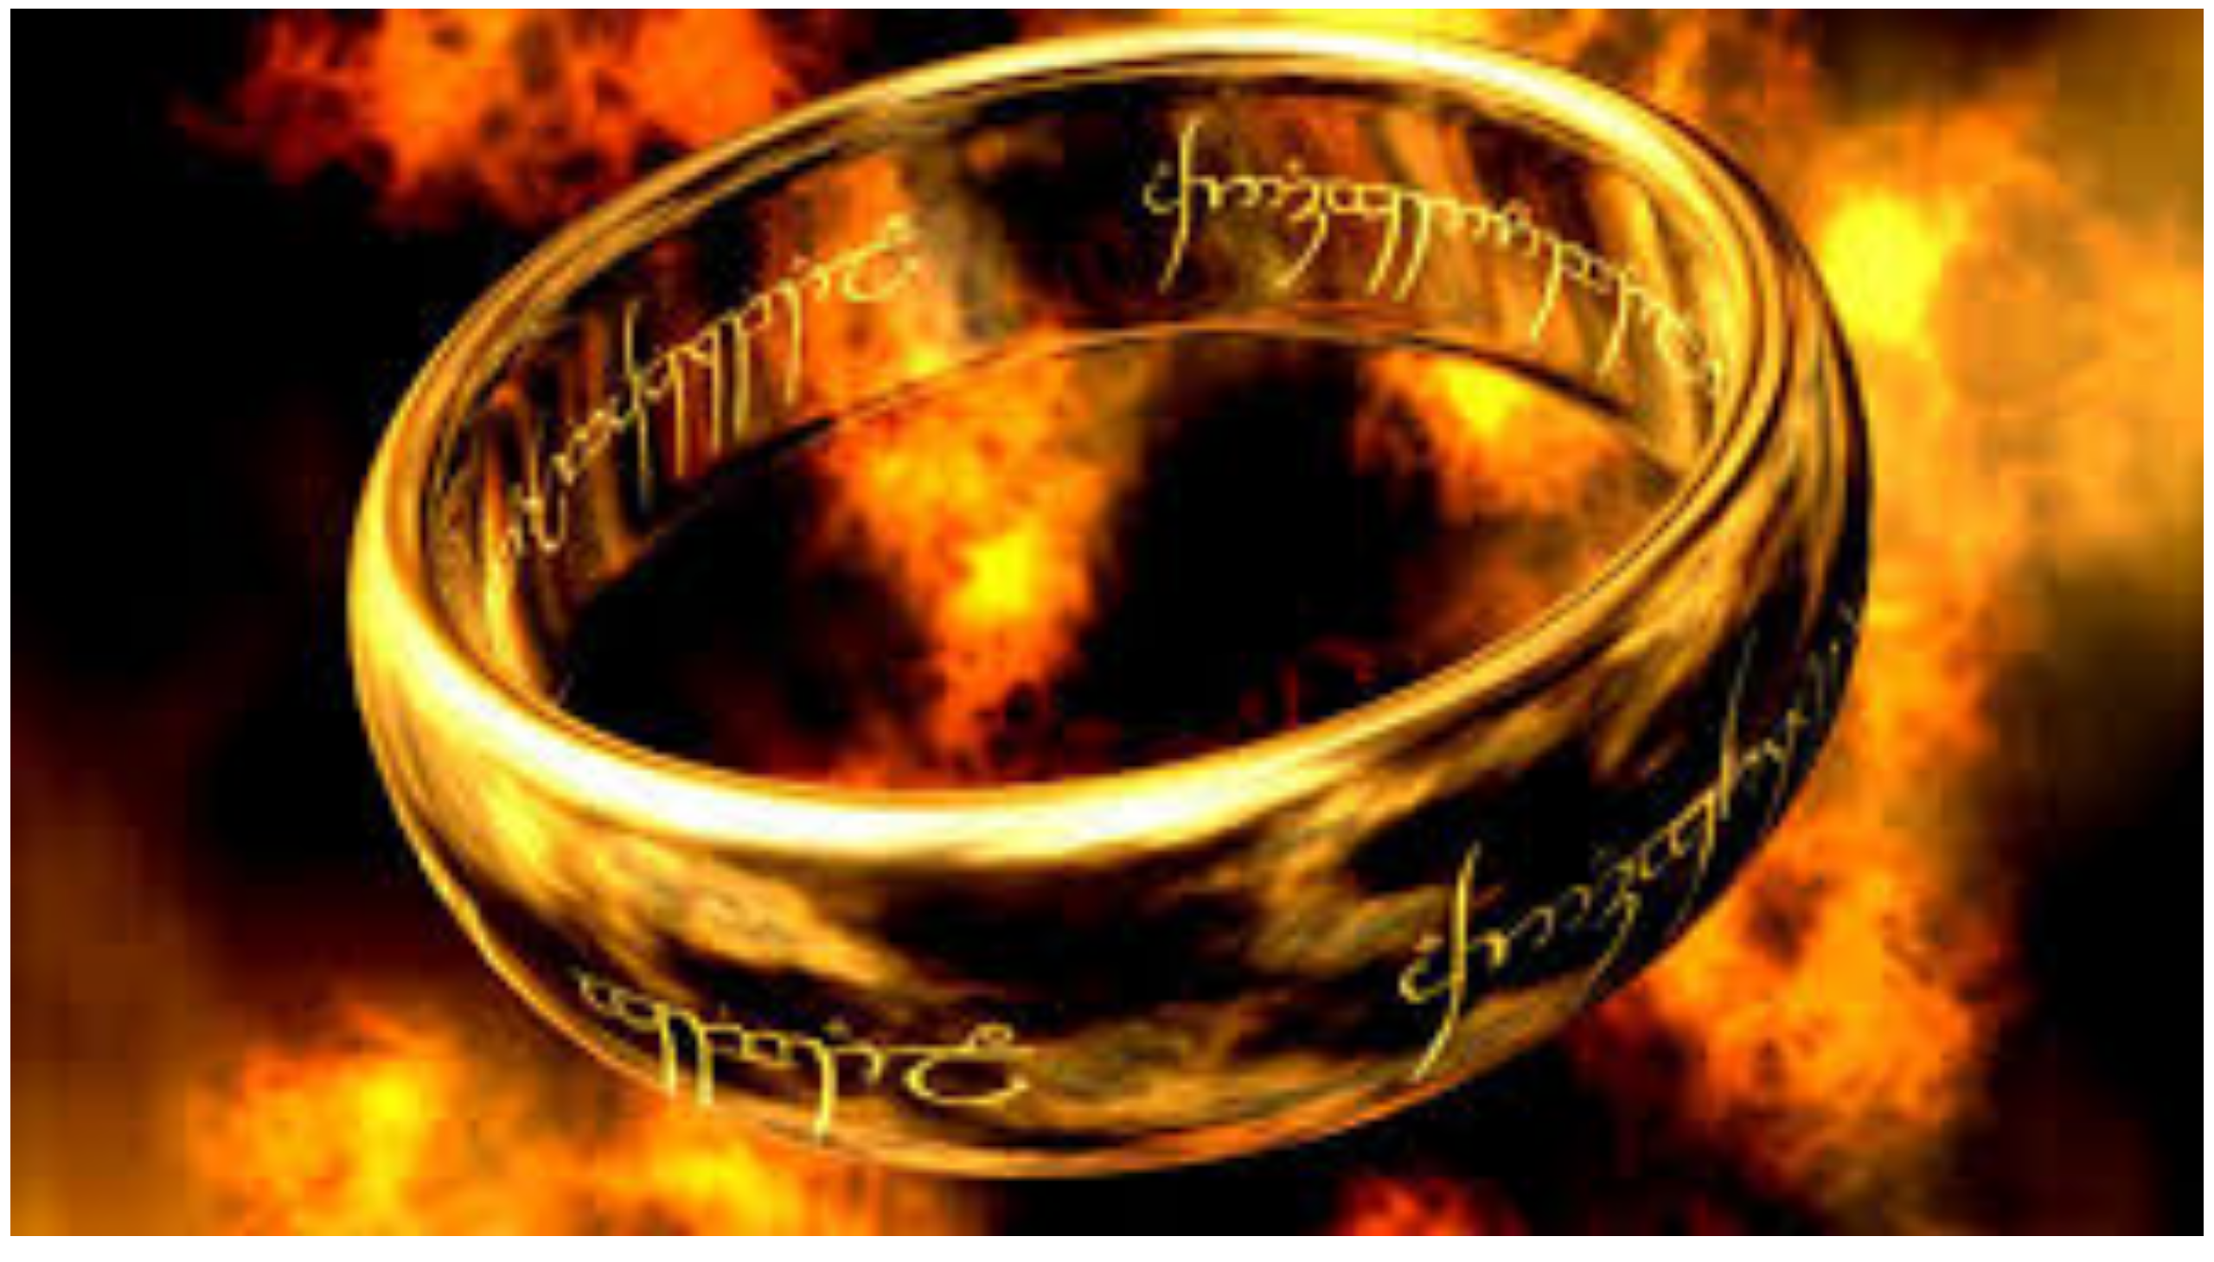
LOTR
Notes:
image
No alt text provided

Slide 3
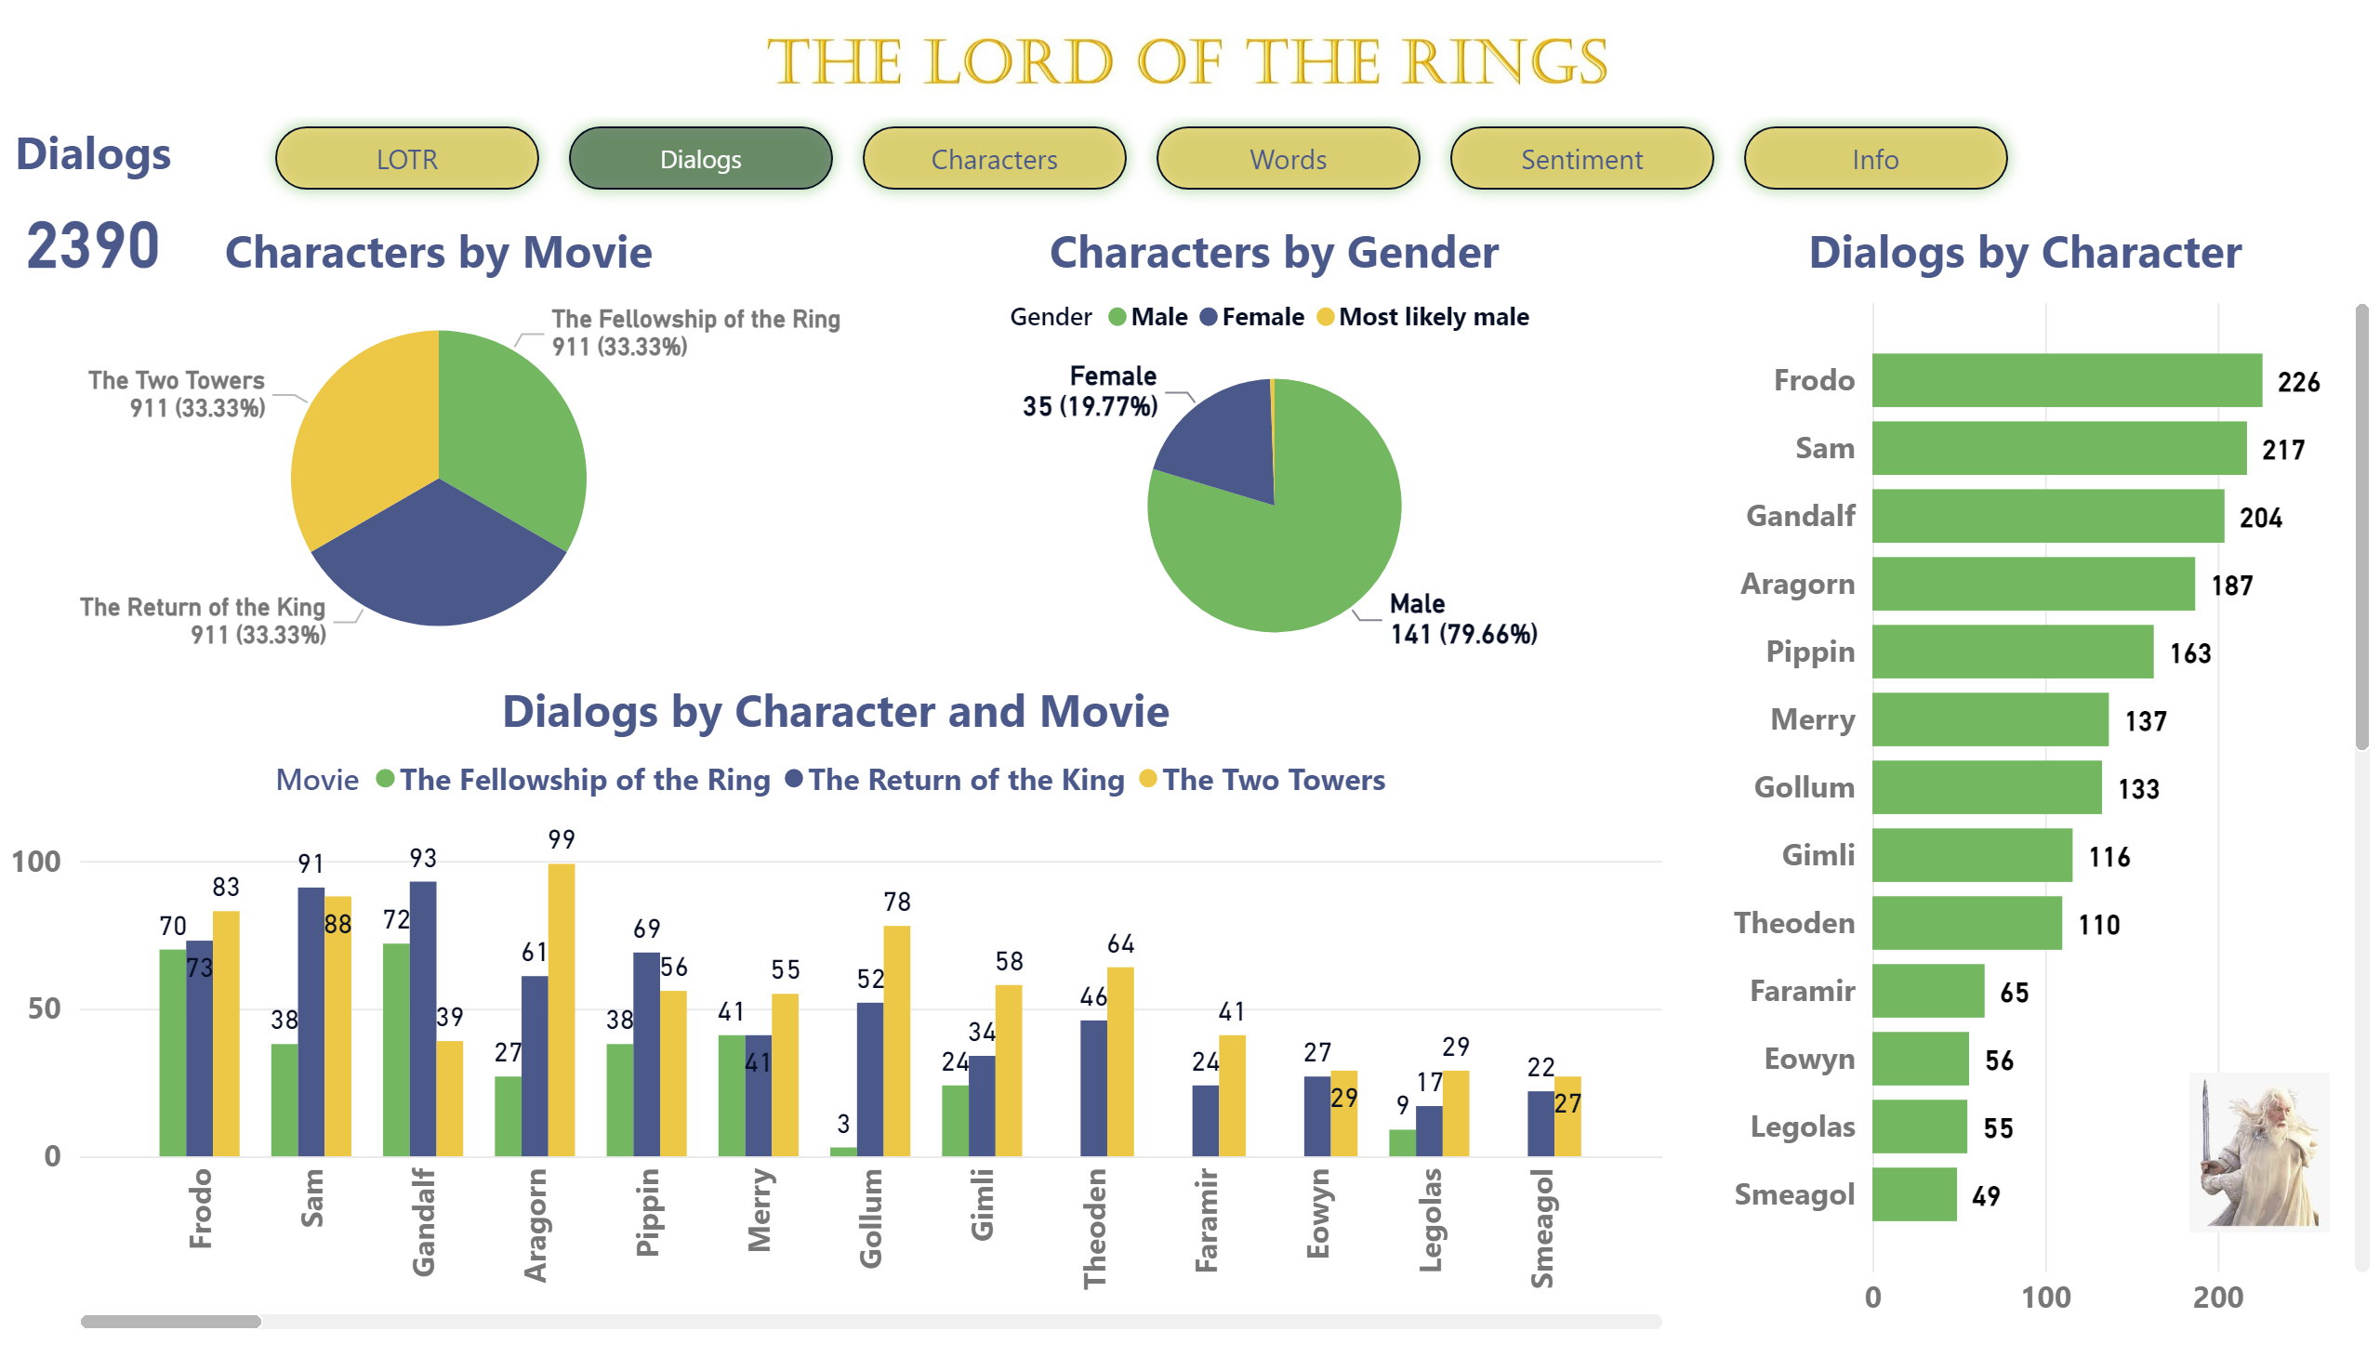
Dialogs
Notes:
Dialogs by Character and Movie
No alt text provided
Dialogs
No alt text provided
Dialogs by Character
No alt text provided
Characters by Movie
No alt text provided
Characters by Gender
No alt text provided
image
No alt text provided
image
No alt text provided
pageNavigator
No alt text provided

Slide 4
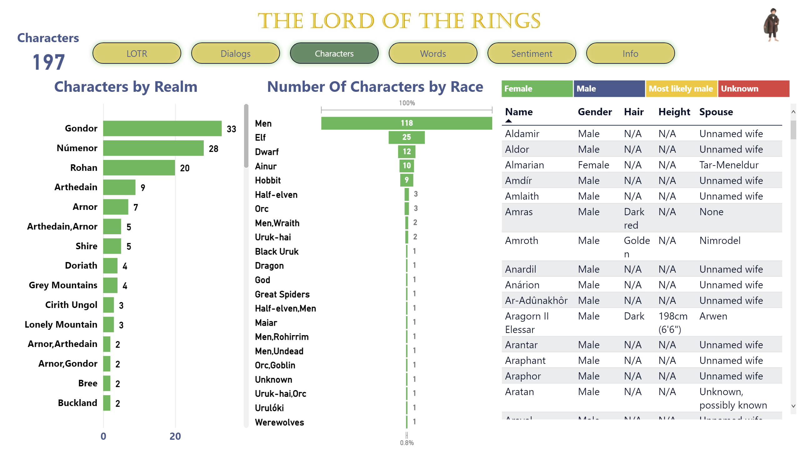
Characters
Notes:
Characters
No alt text provided
Characters by Realm
No alt text provided
funnel
No alt text provided
image
No alt text provided
image
No alt text provided
pageNavigator
No alt text provided
tableEx
No alt text provided
treemap
No alt text provided

Slide 5
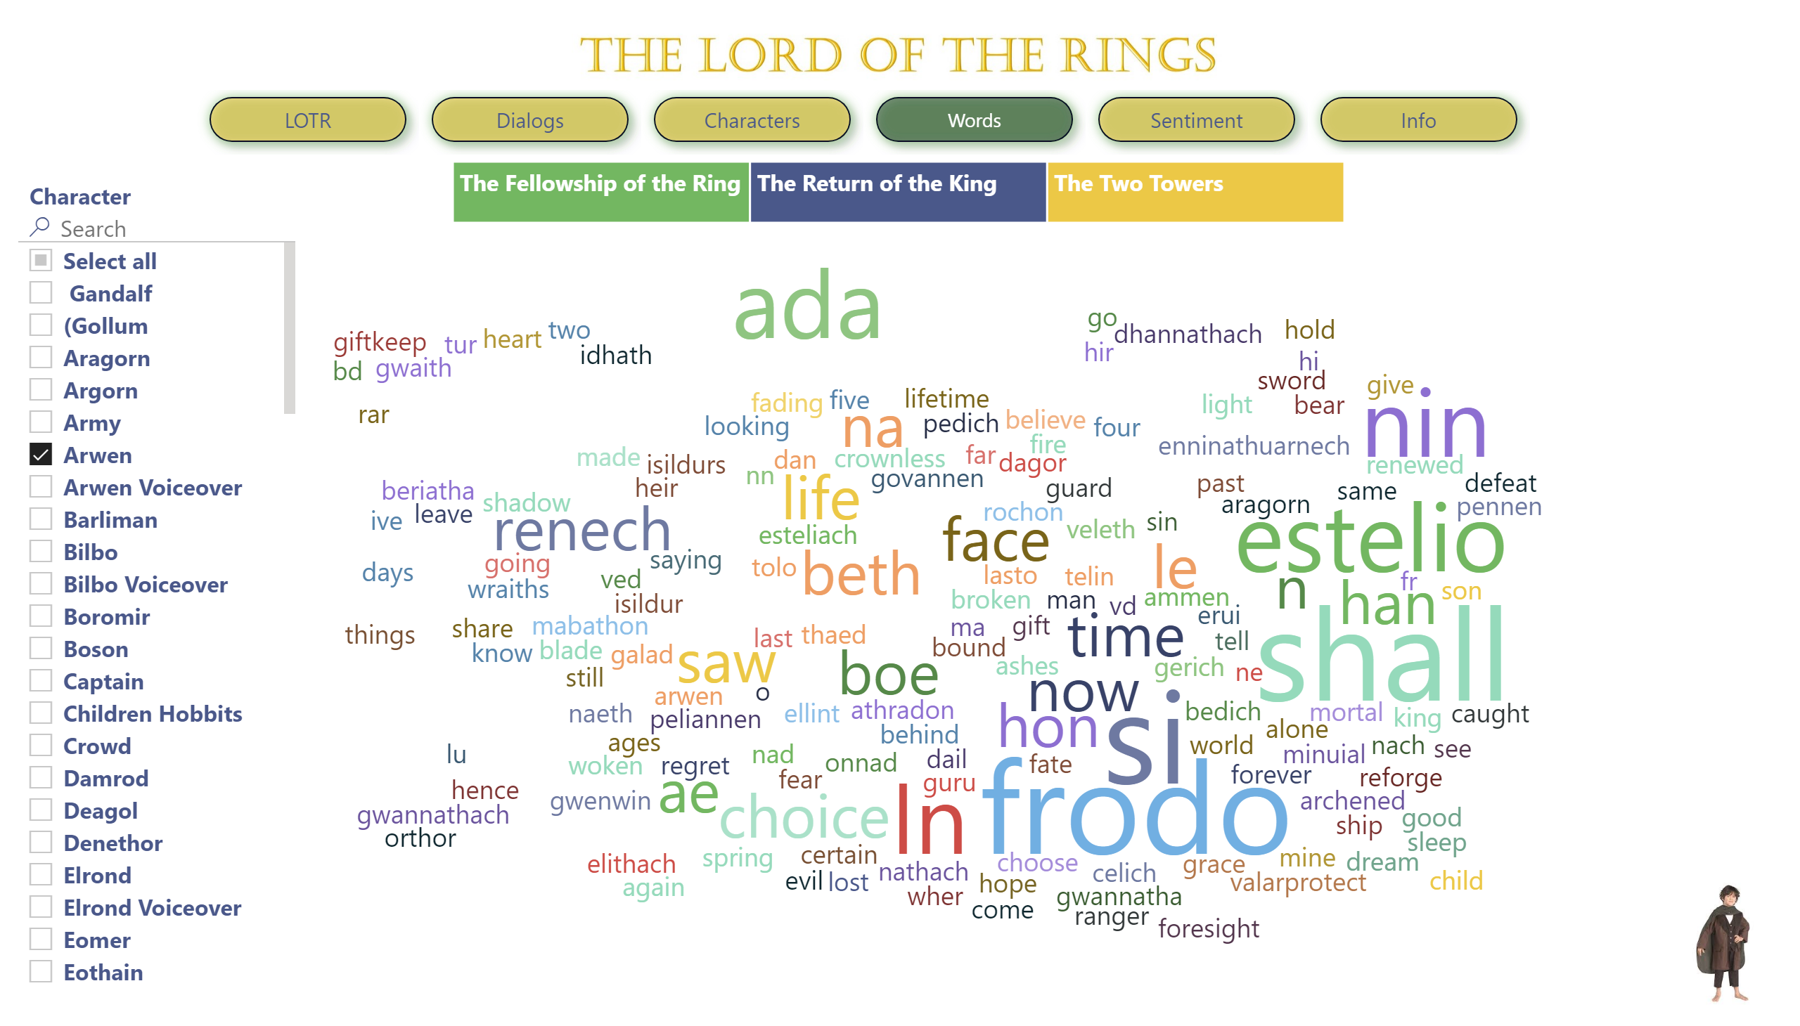
Words
Notes:
pageNavigator
No alt text provided
image
No alt text provided
image
No alt text provided
WordCloud1447959067750
No alt text provided
treemap
No alt text provided
WordCloud1447959067750
No alt text provided
slicer
No alt text provided

Slide 6
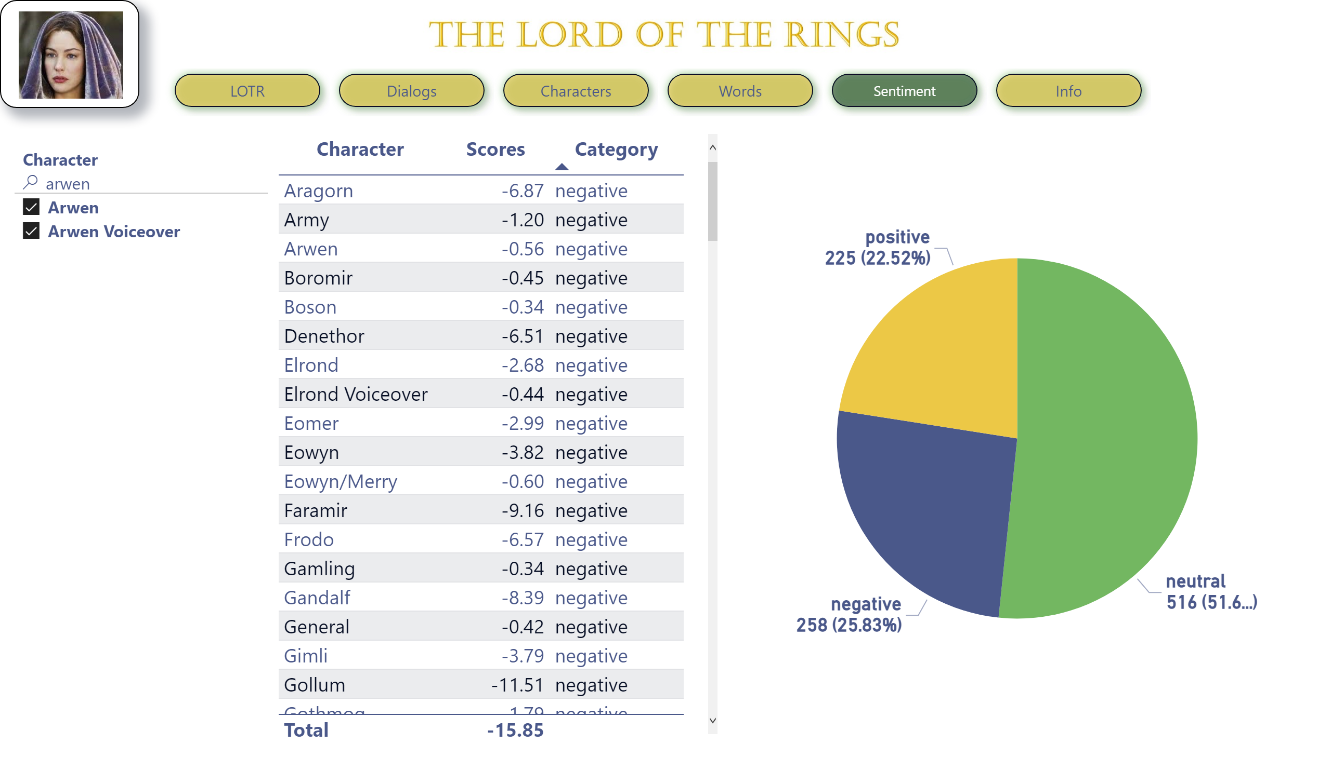
Sentiment
Notes:
image
No alt text provided
pageNavigator
No alt text provided
image
No alt text provided
WordCloud1447959067750
No alt text provided
pieChart
No alt text provided
slicer
No alt text provided
tableEx
No alt text provided

Slide 7
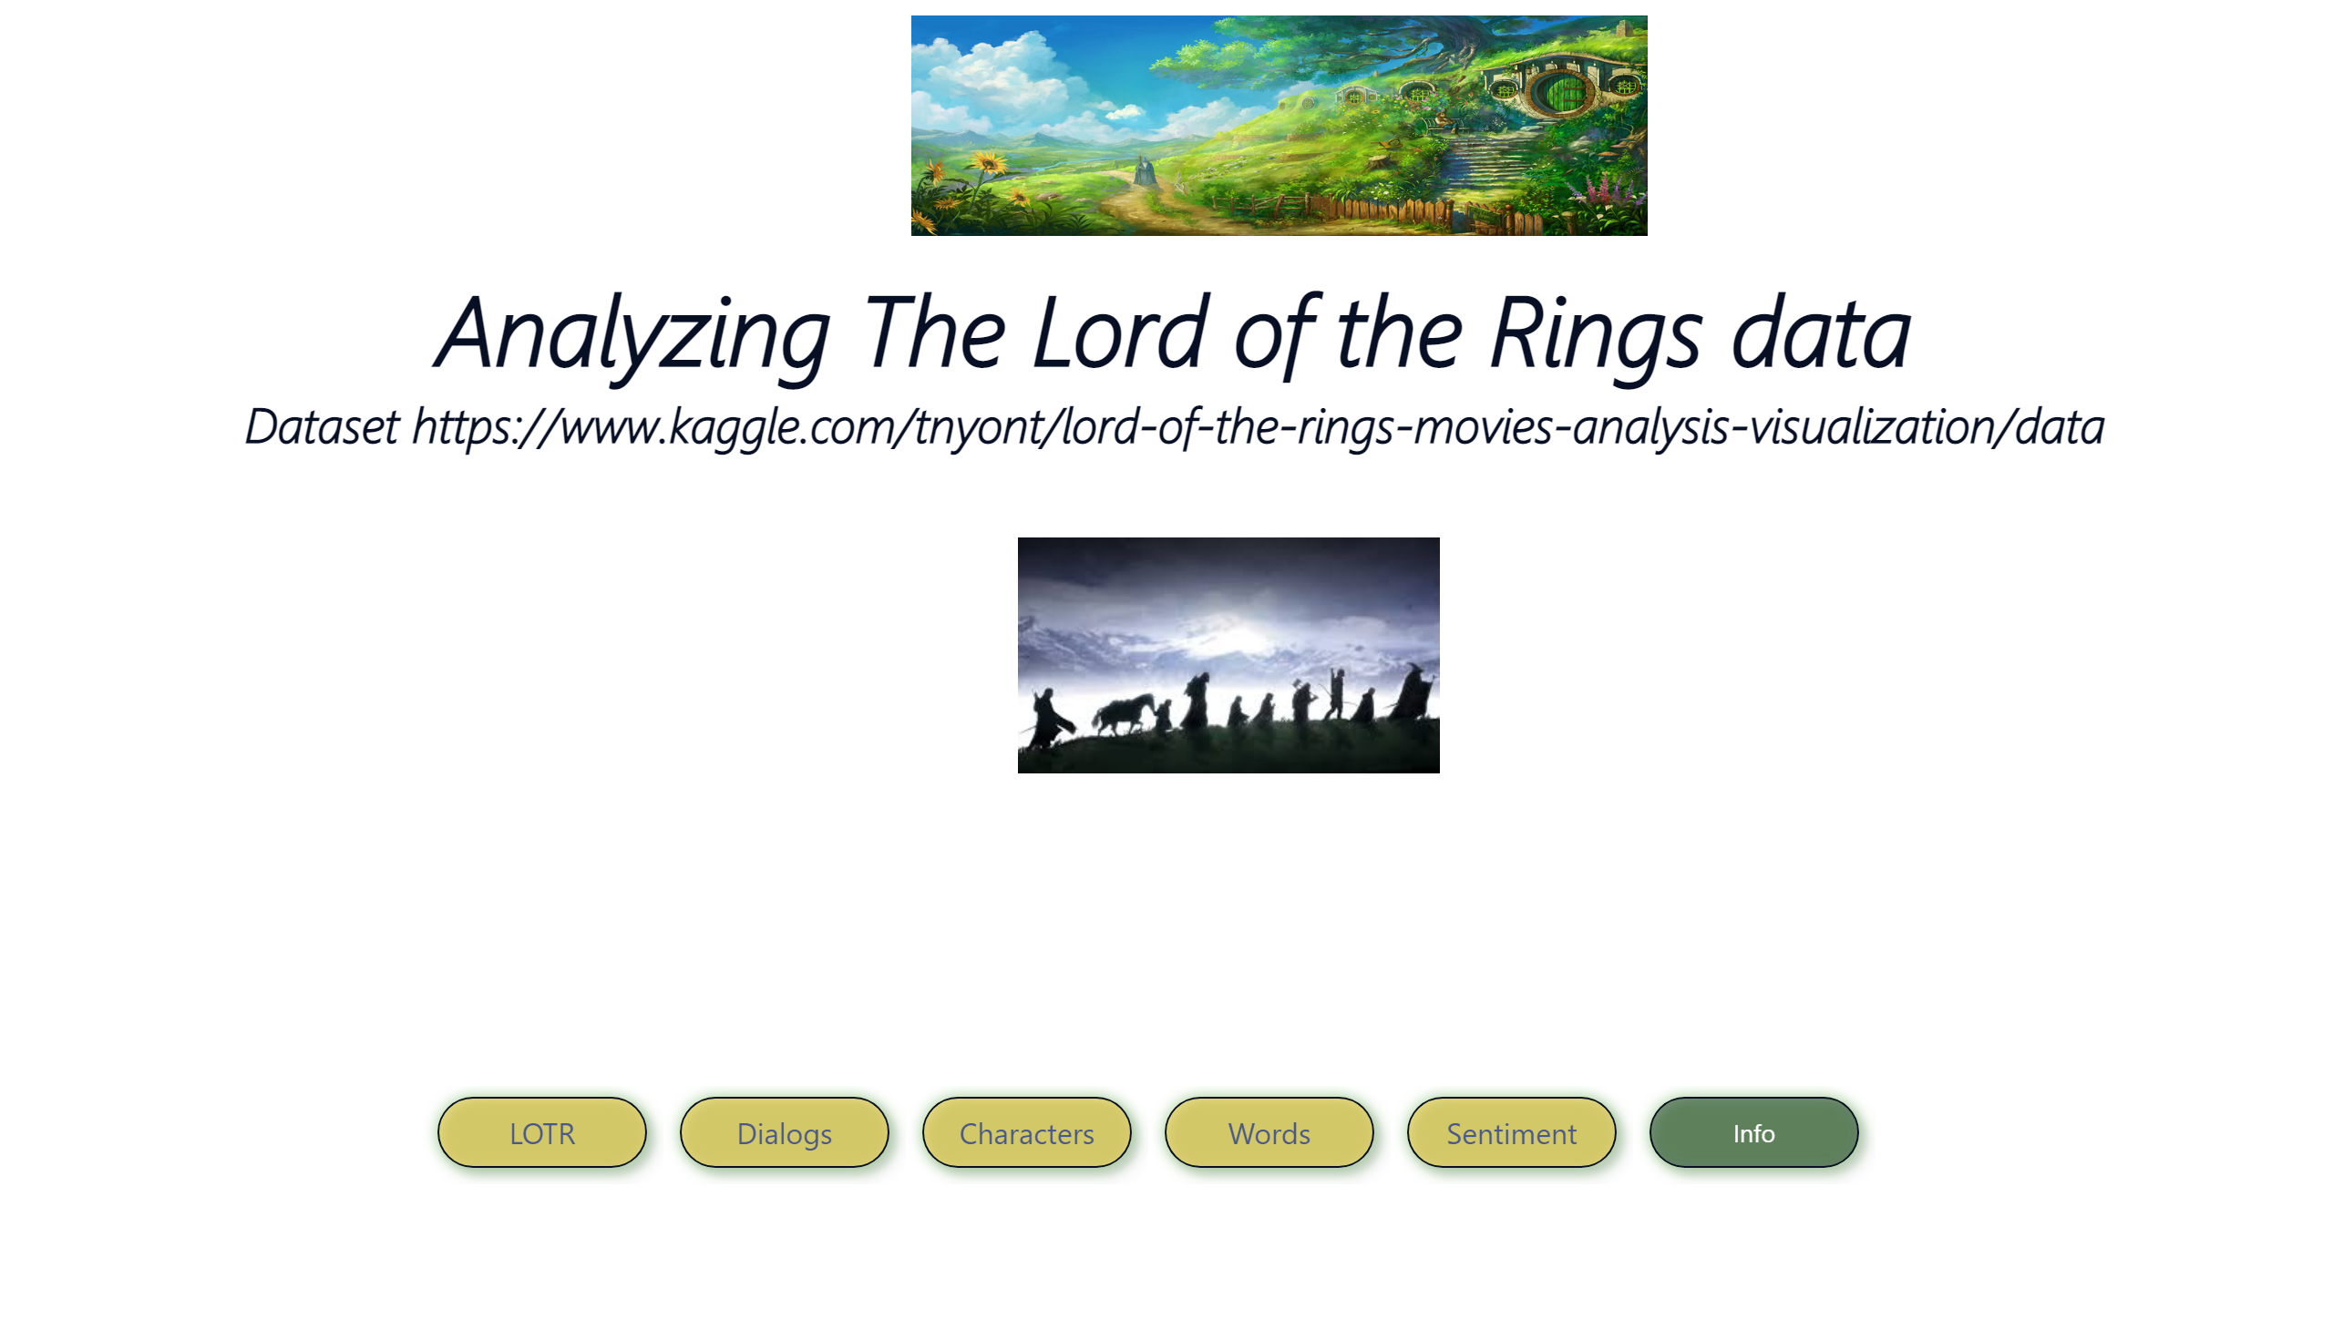
Info
Notes:
textbox
No alt text provided
image
No alt text provided
image
No alt text provided
pageNavigator
No alt text provided

